Slide 1
Customer Buying Behaviour Prediction

Slide 2
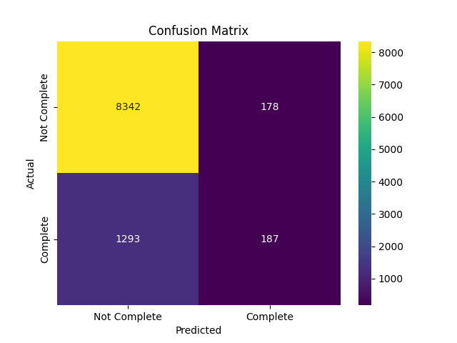
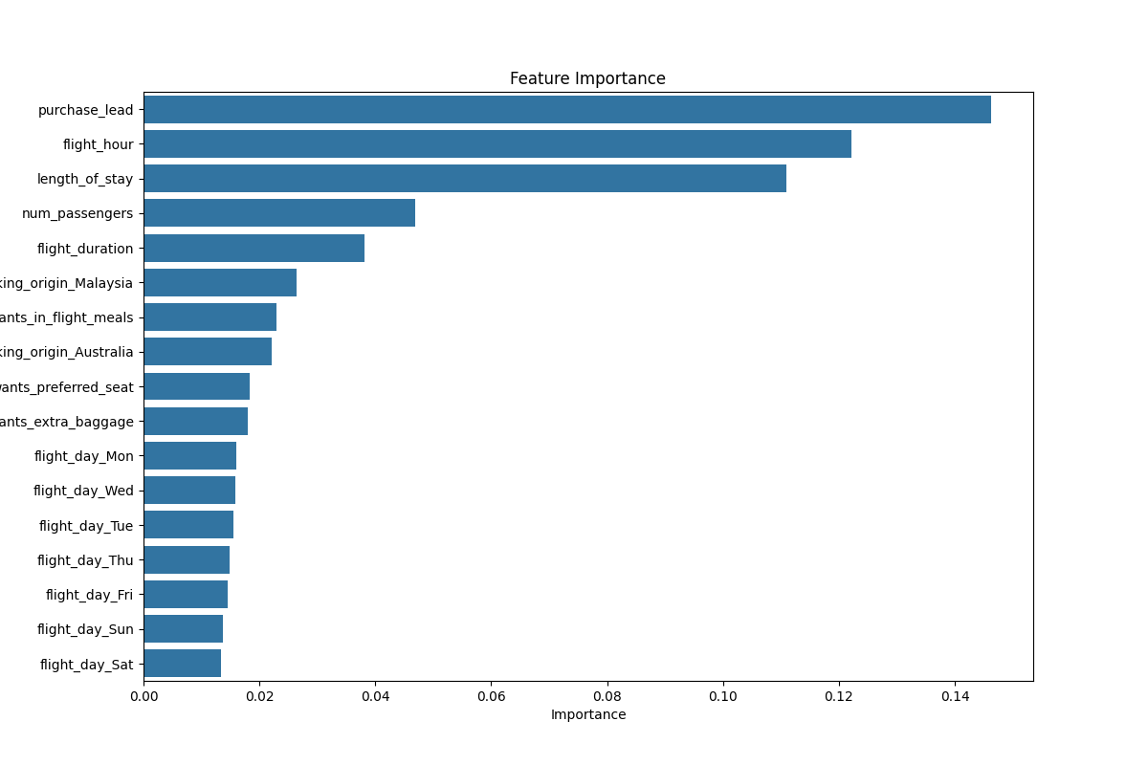
Training Results Analysis (Random Forest)
The confusion matrix highlights that the model has a strong capability in correctly identifying instances where tasks are not complete. However, it struggles to accurately predict when tasks are complete, resulting in a higher number of false negatives and a relatively low count of true positives.
Mean Accuracy: 0.8485
The cross-validation results demonstrate a consistent performance of the model across different subsets of the data, with an average accuracy of approximately 84.85%. This indicates that the model generalizes well to unseen data.
The feature importance analysis identifies purchase_lead, flight_hour, and length_of_stay as the top predictors for the model. These features are critical in determining whether a task will be complete or not. Understanding these key features can help in refining the model further or in making strategic decisions based on the predictions.

